Slide 1



Spring Security Project Setup
m

Slide 2


Add Maven dependencies for Spring Security
Spring Security
spring-security-web
spring-security-config
www.luv2code.com

Slide 3


Spring Projects
Spring Framework (core, aop, mvc…)
Spring Security
•
These are two separate projects
•
The projects are on different release cycles
•
Version numbers between projects are generally not in sync (sigh…)
Spring team is working to resolve this for future releases …
www.luv2code.com

Slide 4
Spring Security
Spring Framework (core, aop, web…)
Spring Security
•
Common pitfall is using incompatible projects
•
Need to find compatible version
www.luv2code.com

Slide 5
Finding Compatible version
•
Find desired version of Spring Security in Maven Central Repo
spring-security-web
•
Look at the project POM file
Find supporting Spring Framework version
www.luv2code.com

Slide 6
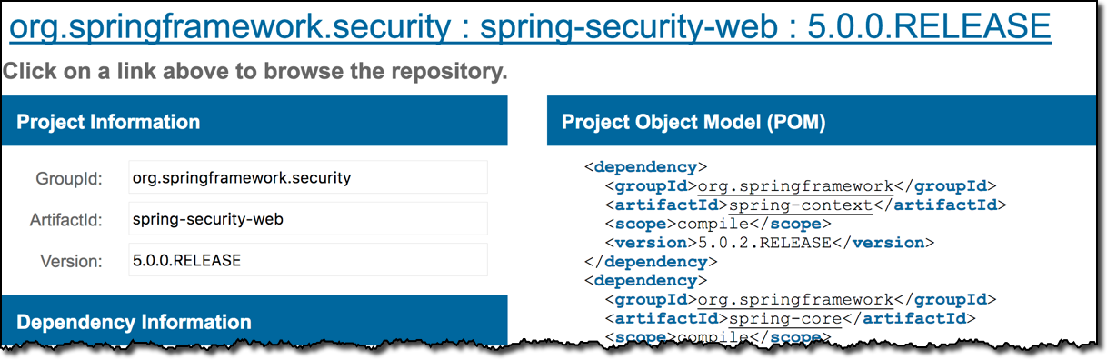
Finding Compatible version
Spring Framework version
Spring Security version
www.luv2code.com

Slide 7
Add Maven dependencies for Spring Security
Spring Security
spring-security-web
spring-security-config
www.luv2code.com

Slide 8

Add Maven dependencies for Spring Security
File: pom.xml
<properties>
<springframework.version>5.0.2.RELEASE</springframework.version>
<springsecurity.version>5.0.0.RELEASE</springsecurity.version>
</properties>
...
<!-- Spring -->
<dependency>
<groupId>org.springframework</groupId>
<artifactId>spring-webmvc</artifactId>
<version>${springframework.version}</version>
</dependency>
<!-- Spring Security -->
<dependency>
<groupId>org.springframework.security</groupId>
<artifactId>spring-security-web</artifactId>
<version>${springsecurity.version}</version>
</dependency>
<dependency>
<groupId>org.springframework.security</groupId>
<artifactId>spring-security-config</artifactId>
<version>${springsecurity.version}</version>
</dependency>
www.luv2code.com

Slide 9
Configuring Basic Security
m

Slide 10
Development Process
Step-By-Step
Create Spring Security Initializer
Create Spring Security Configuration (@Configuration)
Add users, passwords and roles
www.luv2code.com

Slide 11

Spring Security Web App Initializer
•
Spring Security provides support for security initialization
•
Your security code is used to initialize the servlet container
•
Special class to register the Spring Security Filters
AbstractSecurityWebApplicationInitializer
www.luv2code.com

Slide 12

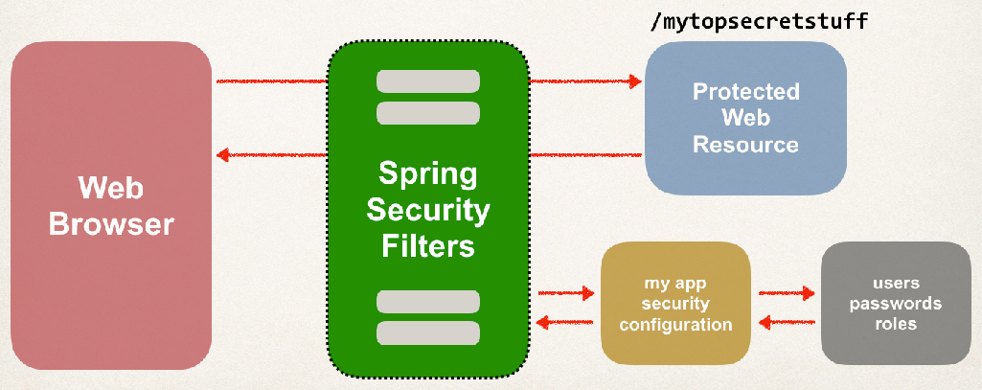
Spring Security Web App Initializer
AbstractSecurityWebApplicationInitializer
•
Special class to register the Spring Security Filters
www.luv2code.com

Slide 13
Spring Security Web App Initializer (more info)
AbstractSecurityWebApplicationInitializer
•
Your TO DO list
•
Extend this abstract base class
•
that’s it!
www.luv2code.com

Slide 14

Step 1: Create Spring Security Initializer
File: SecurityWebApplicationInitializer.java
import org.springframework.security.web.context.AbstractSecurityWebApplicationInitializer;
public class SecurityWebApplicationInitializer extends AbstractSecurityWebApplicationInitializer {
}
www.luv2code.com

Slide 15

Step 2: Create Spring Security Configuration
File: DemoSecurityConfig.java
import import import
org.springframework.context.annotation.Configuration; org.springframework.security.config.annotation.web.configuration.EnableWebSecurity; org.springframework.security.config.annotation.web.configuration.WebSecurityConfigurerAdapter;
@Configuration @EnableWebSecurity
public class DemoSecurityConfig
}
extends WebSecurityConfigurerAdapter {
www.luv2code.com

Slide 16

Step 3: Add users, passwords and roles
File: DemoSecurityConfig.java
@Configuration @EnableWebSecurity
public class
@Override protected
DemoSecurityConfig extends WebSecurityConfigurerAdapter {
void configure(AuthenticationManagerBuilder auth) throws Exception {
// add our users for in memory authentication
UserBuilder users = User.withDefaultPasswordEncoder(); auth.inMemoryAuthentication()
.withUser(users.username("john").password("test123").roles("EMPLOYEE"))
.withUser(users.username("mary").password("test123").roles("MANAGER"))
.withUser(users.username("susan").password("test123").roles("ADMIN"));
}
www.luv2code.com

Slide 17
Step 3: Add users, passwords and roles
File: DemoSecurityConfig.java
@Configuration @EnableWebSecurity
public class
@Override protected
DemoSecurityConfig extends WebSecurityConfigurerAdapter {
void configure(AuthenticationManagerBuilder auth) throws Exception {
// add our users for in memory authentication
UserBuilder users = User.withDefaultPasswordEncoder(); auth.inMemoryAuthentication()
.withUser(users.username("john").password("test123").roles("EMPLOYEE"))
.withUser(users.username("mary").password("test123").roles("MANA_{W}GE_{e}R"_{w}))_{ill add DB support in}
.withUser(users.username("susan").password("test123").roles("ADMIN"));
later videos
}
(plaintext and encrypted)
www.luv2code.com

